Slide 1
Connectionist Computing
COMP 30230/41390
Gianluca Pollastri
office: CASL, ground floor Science East.
email: gianluca.pollastri@ucd.ie
Connectionist Computing COMP 30230

Slide 2



Credits
Geoffrey Hinton, University of Toronto.
  borrowed some of his slides for “Neural Networks” and “Computation in Neural Networks” courses.
Ronan Reilly, NUI Maynooth.
  slides from his CS4018.
Paolo Frasconi, University of Florence.
  slides from tutorial on Machine Learning for structured domains.
Connectionist Computing COMP 30230

Slide 3
Lecture notes on Moodle
https://csmoodle.ucd.ie/moodle/course/view.php?id=288
Strictly confidential...
Enrolment key: 30230cc
Connectionist Computing COMP 30230

Slide 4
Books
No book covers large fractions of this course.
Parts of chapters 4, 6, (7), 13 of Tom Mitchell’s “Machine Learning”
Parts of chapter V of Mackay’s “Information Theory, Inference, and Learning Algorithms”, available online at:
http://www.inference.phy.cam.ac.uk/mackay/itprnn/book.html
Chapter 20 of Russell and Norvig’s “Artificial Intelligence: A Modern Approach”, also available at:
http://aima.cs.berkeley.edu/newchap20.pdf
More materials later..
Connectionist Computing COMP 30230

Slide 5
Marking
3 landmark papers to read, and submit a 10-line summary on Moodle about: each worth 6.67%
a small connectionist tool to build and play with: 30%
Final exam: 50%
Connectionist Computing COMP 30230

Slide 6
Assignment 1
Read the first section of the following article by Marvin Minsky:
http://web.media.mit.edu/~minsky/papers/SymbolicVs.Connectionist.html
down to “.. we need more research on how to combine both types of ideas.”
Submit through Moodle a 250 word MAX summary by February 14th at 23:59, any time zone of your choice (Baker Island?).
One third of a grade down every day late, that is: if you deserve an A and you’re 1 day late you get an A-, 2 days late a B+, etc.
Make sure it's gone through!
Connectionist Computing COMP 30230

Slide 7
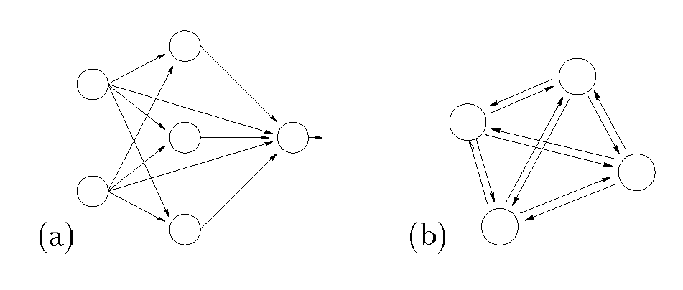
Feedforward and feedback networks
FF is a DAG (Directed Acyclic Graph). Perceptrons, Associators are FF networks.
FB has loops (i.e., not Acyclic)
Connectionist Computing COMP 30230

Slide 8
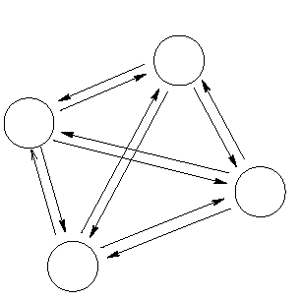
Hopfield Nets
Networks of binary threshold units.
Feedback networks: each units has connections to all other units except itself.
Connectionist Computing COMP 30230

Slide 9
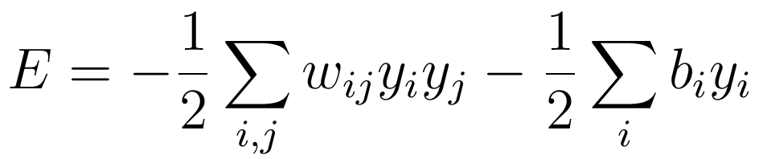
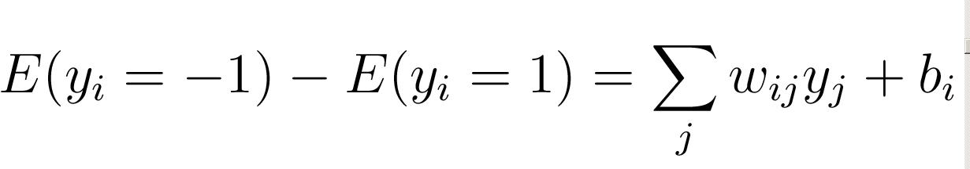
The energy function
The global energy is the sum of many contributions. Each contribution depends on one connection weight and the binary states of two neurons:
The simple energy function makes it easy to compute how the state of one neuron affects the global energy (it is the activation of neuron!):
Connectionist Computing COMP 30230

Slide 10
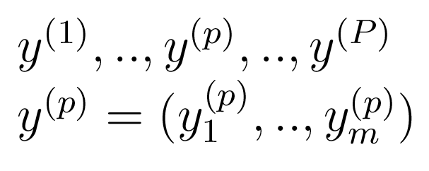
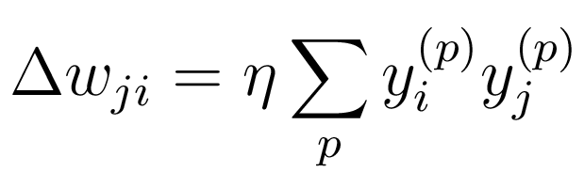
Storing memories (learning)
If we want to store a set of memories:
if the states are –1 and +1 then we can use the update rule:
Connectionist Computing COMP 30230

Slide 11
Critical state
P/N > 0.14 : no minimum is related to the learned patterns.
0.14 > P/N > 0.05 : both learned and other minima. Other minima tend to dominate.
0.05 > P/N > 0 : both learned and other minima. Learned minima dominate (lower energy).
Connectionist Computing COMP 30230

Slide 12
An iterative storage method
Instead of trying to store vectors in one shot as Hopfield does, cycle through the training set many times and make small weight changes.
  This uses the capacity of the weights more efficiently.
  Very much like Kohonen’s extension to Linear Associators.
Connectionist Computing COMP 30230

Slide 13
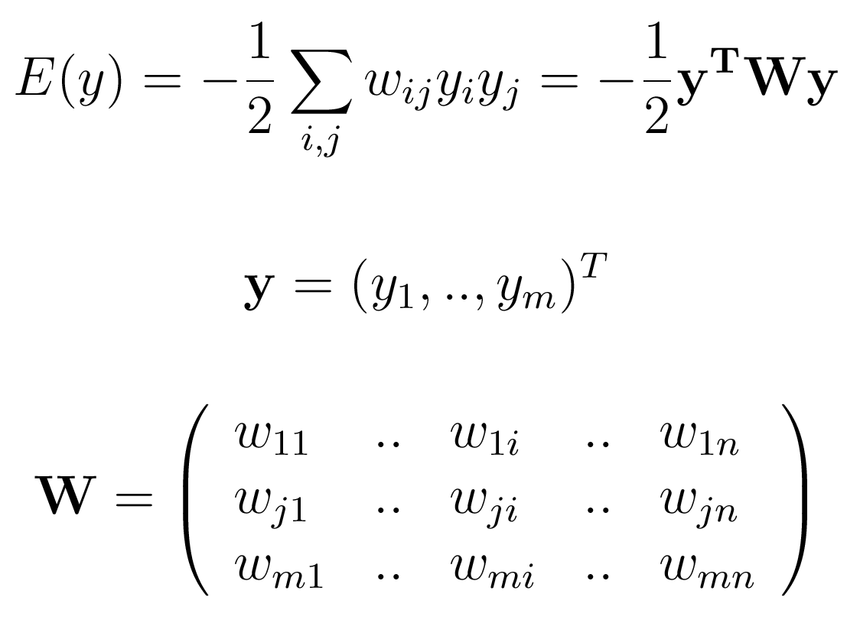
From Hopfield nets to Boltzmann machine
Hopfield nets (attempt to) minimise an energy function:
Connectionist Computing COMP 30230

Slide 14
Stochastic units
Replace the binary threshold units by binary stochastic units. A neuron is switched on/off with a certain probability instead of deterministically.
Connectionist Computing COMP 30230

Slide 15
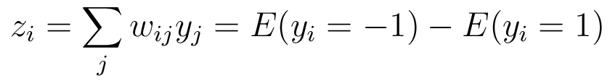
Stochastic units
Reminder: the energy reduction by switching a neuron on is:
Connectionist Computing COMP 30230

Slide 16
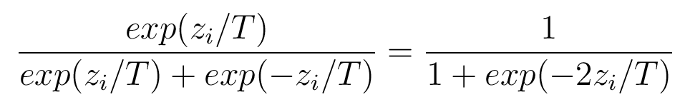
Stochastic units
The probability that a given unit is switched on is a function of the amount of energy that its change of state would contribute to the network's overall energy, and the "temperature" T.
Connectionist Computing COMP 30230

Slide 17
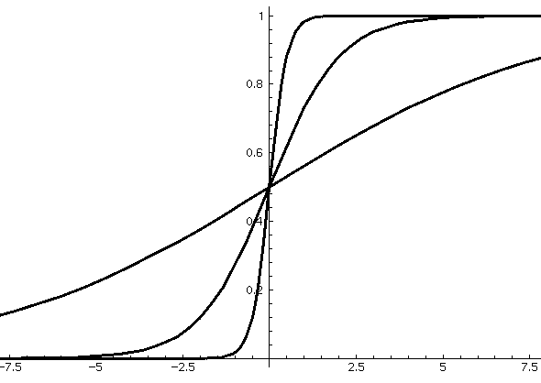

p
(
y
=1)
k
T=4.0
T=1.0
T=0.25
Connectionist Computing COMP 30230

Slide 18
Hopfield vs. Boltzmann
Since in Boltzmann networks the unit update rule (or activation function) has a probabilistic component, if we allow the network to run it will settle into a given equilibrium state only with a certain probability.
Hopfield networks, on the other hand, are deterministic. Given an initial state their equilibrium state is determined.
Connectionist Computing COMP 30230

Slide 19
Stochastic units
Temperature makes it easier to cross energy barriers.
  Start at high temperature where its easy to cross energy barriers.
  Reduce slowly to low temperature where good states are much more probable than bad ones.
A B C
Connectionist Computing COMP 30230

Slide 20
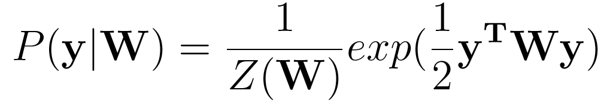
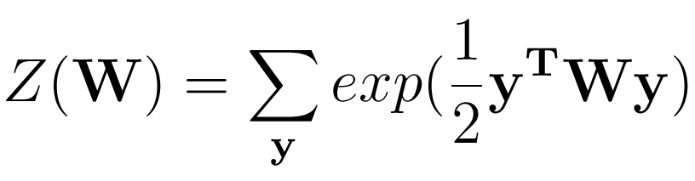
Implementing a probability distribution
It can be shown that the Boltzmann machine generates configurations according to the distribution:
Where:
Connectionist Computing COMP 30230

Slide 21
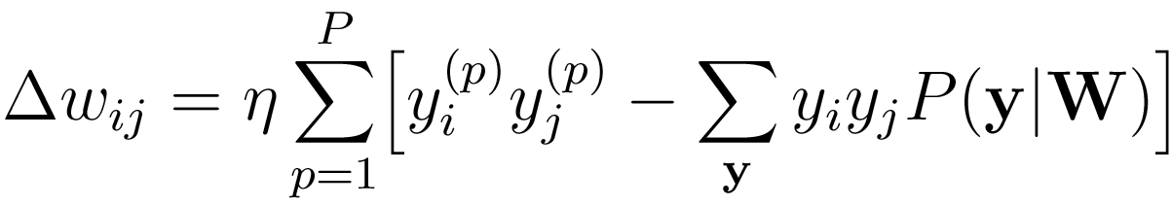
Learning in the Boltzmann machine
Working on the probability distribution it is possible to devise the following learning rule:
Connectionist Computing COMP 30230

Slide 22
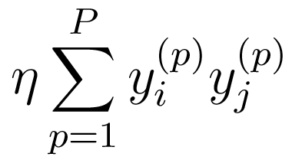
Learning in the Boltzmann machine
First term:
Empirical correlation between neurons i and j, measured from the examples (same as learning rule for Hopfield).
Connectionist Computing COMP 30230

Slide 23
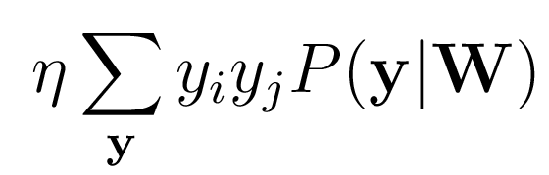
Learning in the Boltzmann machine
Second term:
Correlation between neurons i and j, measured on patterns generated according to the probability distribution underlying the model. Notice that we’re summing over all possible patterns (2^{N})
Connectionist Computing COMP 30230

Slide 24
Learning in the Boltzmann machine
The first term is readily evaluated from the examples.
The second term can be estimated by letting the model evolve until equilibrium, measuring the correlations, and repeating many times: can be computationally tough.
Monte Carlo.
Connectionist Computing COMP 30230

Slide 25
Interpretation of learning terms
First term: the network is awake and measures the correlations in the real world.
Second term: the network sleeps and dreams about the world using the model it has of it.
Once dream and reality coincide learning reaches an end. It is interesting to notice that the network unlearns its dreams.
Connectionist Computing COMP 30230

Slide 26
Weakness of Hopfield nets and Boltzmann machines
All units are visible, i.e. correspond to observable stuff (components of the examples).
In this situation nothing more than second order interactions can be captured by Hopfield nets and the Boltzmann machine.
If for instance the examples are bits of images, second order statistics are a poor representation.
Connectionist Computing COMP 30230

Slide 27
Hidden units for Hopfield nets/Boltzmann machines
Hidden units. Used to represent an interpretation of the inputs
Instead of using the net just to store memories, use it to construct interpretations of the input.
  The input is represented by the visible units.
  The interpretation is represented by the states of the hidden units.
Higher order correlations can be represented by hidden units.
More powerful model, but even harder to train.
Visible units. Used to represent the inputs
Connectionist Computing COMP 30230

